Slide 1
Highway Planning & Design Lecture - 8
Designed and presented
By
Asst. Prof. Dr. Raquim Nihad Zehawi

Slide 2
SUPERELEVATION
The inclination of the roadway toward the center of the curve is known as superelevation
When a vehicle is moving around a circular curve it endures a centrifugal acceleration
In order to balance the effect of the centrifugal acceleration, the road is inclined toward the center of the curve

Slide 3
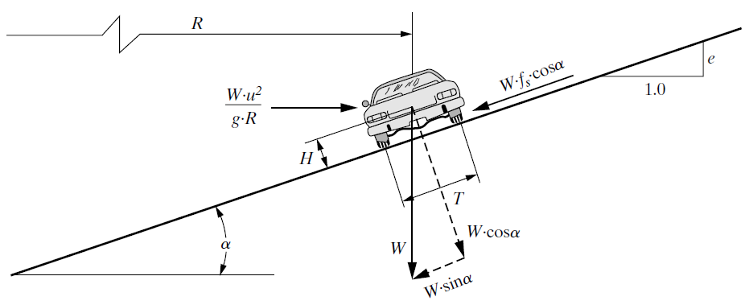
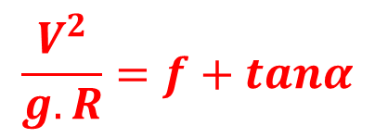
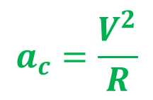

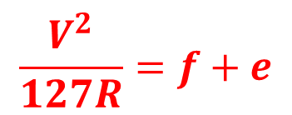
$$a_{c}=\frac{V^{2}}{R}$$
Centrifugal force$=F=m.a_{c}$
$$F=\frac{W}{g}.\frac{V^{2}}{R}$$
On the road surface
$$F.cosα=f\left(W.cosα+F.sinα\right)+W.sinα$$
$$\frac{W}{g}.\frac{V^{2}}{R}.cosα=fW.cosα+W.sinα$$
$$\frac{V^{2}}{g.R}=f+tanα$$
$$\frac{V^{2}}{127R}=f+e$$
V in Km/h
R in meters
f = 0.11 – 0.16

Slide 4
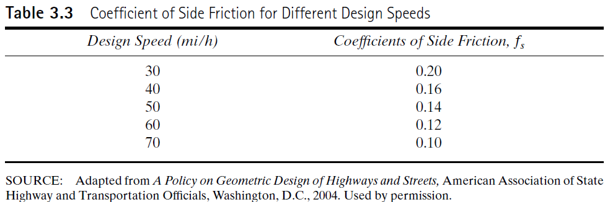

Slide 5
Maximum Superelevation Rates
The maximum rates of superelevation used on highways are controlled by four factors:
Climate conditions (i.e., frequency and amount of snow and ice)
terrain conditions (i.e., flat, rolling, or mountainous)
type of area (i.e., rural or urban)
frequency of very slow-moving vehicles
Minimum Radius
The minimum radius is a limiting value of curvature for a given design speed and is determined from the maximum rate of superelevation and the maximum side friction factor selected for design

Slide 6
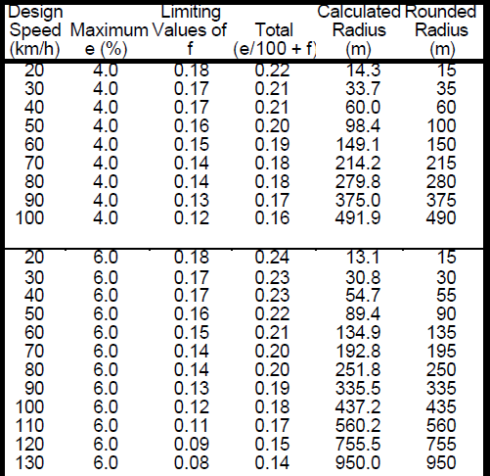

Slide 7
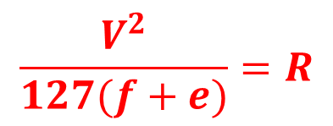
Example 10
Minimum Radius of a Highway Horizontal Curve
An existing horizontal curve has a radius of 140 m, which restricts the posted speed limit on this section of the road to only 63.6% of the design speed. If the curve is to be improved so that its posted speed will be the design speed, determine the minimum radius of the new curve.
$e=0.08 for both curves$
Solution:
Assume that $f=0.15$
$$\frac{V^{2}}{127R}=f+e$$
$$\frac{{(0.636DS)}^{2}}{127×140}=0.15+0.08$$
$$DS=100 km/h$$
Check assumption for 63.6% of DS in Table $f=0.15$ is acceptable and for DS $f=0.12$
$$\frac{V^{2}}{127(f+e)}=R$$
$$R=\frac{{100}^{2}}{127(0.12+0.08)}$$
$$R=393.7 m$$

Slide 8
Transition Design Controls
The design of transition sections includes consideration of transitions in the roadway cross slope and possible transition curves incorporated in the horizontal alignment
superelevation transition
Alignment transition
The superelevation transition section consists of the superelevation runoff and tangent runout sections
Tangent Runout Length:
The length required to transition the outside lane of the roadway from a normal crowned section to a point where the outside lane have zero (flat) cross slope
Superelevation runoff length:
The length of highway section required to achieve a full superelevated section from a flat section is known a superelevation runoff.

Slide 9
Tangent-to-Curve Transition
Minimum length of superelevation runoff
For appearance and comfort, the length of superelevation runoff should be based on a maximum acceptable difference between the longitudinal grades of the axis of rotation and the edge of pavement
The maximum relative gradient is varied with design speed to provide longer runoff lengths at higher speeds and shorter lengths at lower speeds
relative gradients of 0.80 and 0.35 percent provide acceptable runoff lengths for design speeds of 20 and 130 km/h [15 and 80 mph], respectively

Slide 10
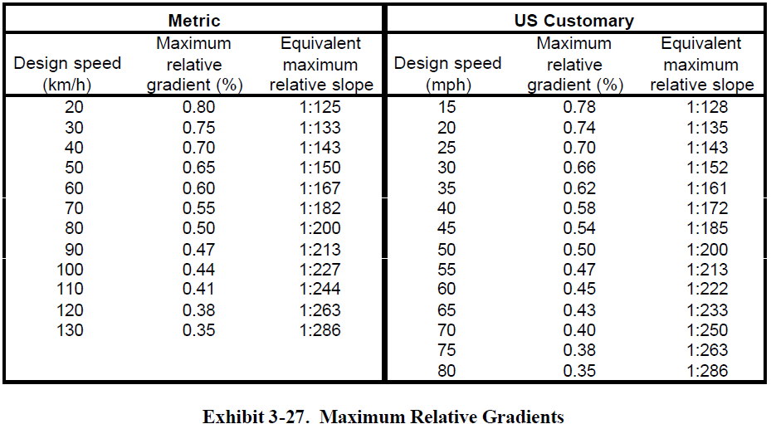

Slide 11
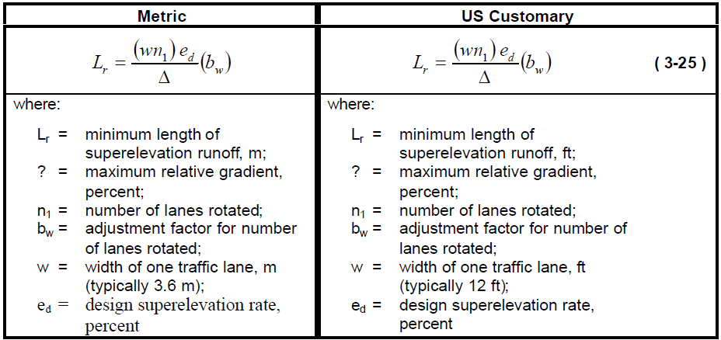
MINIMUM LENGTH OF RUNOFF

Slide 12
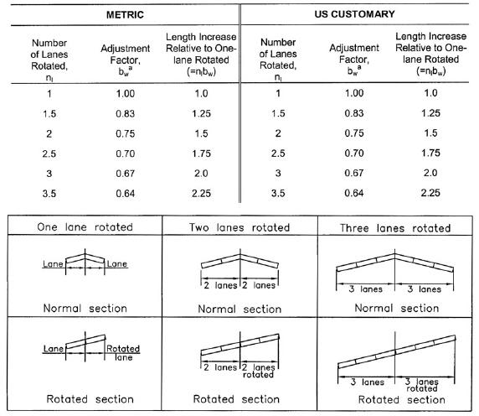
Exhibit 3-28.
Adjustment Factor for Number of Lanes Rotated

Slide 13
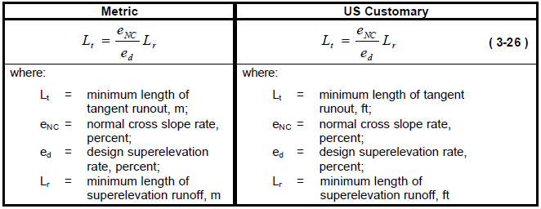
Minimum length of tangent runout
The length of tangent runout is determined by the amount of adverse cross slope to be removed and the rate at which it is removed

Slide 14
